Slide 1
For loops

Slide 2
Outline
In this lesson, we will:
Describe for loops and their implementation in C++
Describe their purpose
Specifically count-controlled loops

Slide 3
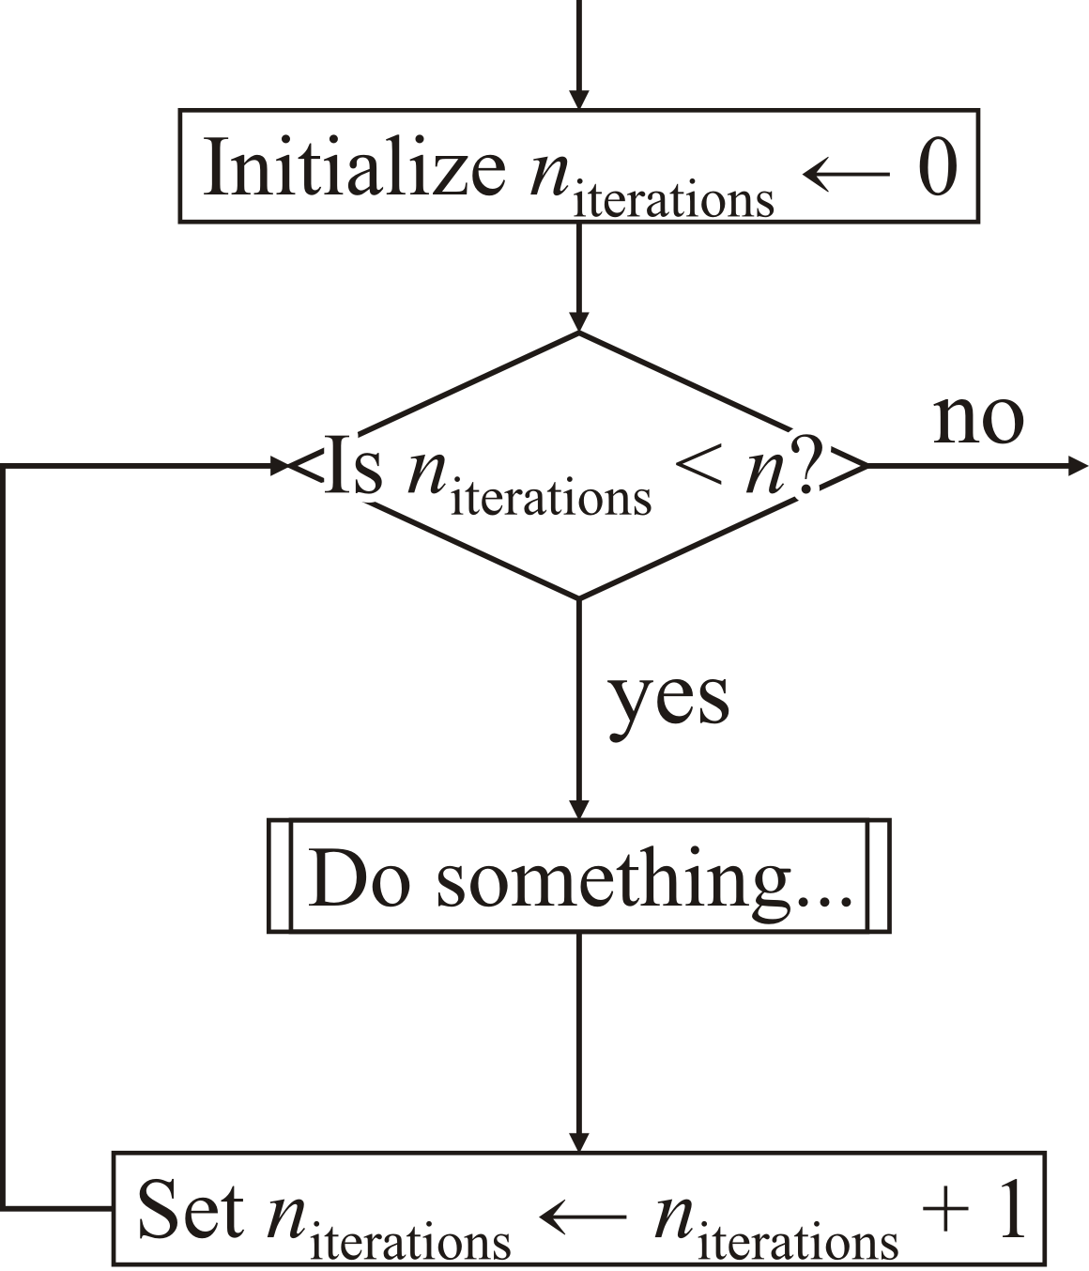
Count-controlled loops
We previous looked at executing a block of code a fixed number of times:
unsigned int num_iterations{0};
while ( num_iterations < max_iterations ) {
// Do something...
++num_iterations;
}

Slide 4
Count-controlled loops
This is so common, it is given a short form:
unsigned int k{0};
while ( k < n ) {
// Do something...
++k;
}
for ( unsigned int k{0}; k < n; ++k ) {
// Do something...
}

Slide 5
Count-controlled loops
This form is called a for loop:
for ( unsigned int k{0}; k < n; ++k ) {
// Do something...
}
The format gives a clean presentation of a count-controlled loop
All you need to know about the loop is on one line
Initialization statement
Incremental statement
Conditional expression

Slide 6
Count-controlled loops
Behavior:
for ( unsigned int k{0}; k < n; ++k ) {
// Do something...
}
First, the initialization statement is executed
Before each execution of the block of statements, the condition is checked
If the condition is false, the for loop exits
After all statements in the block are executed, the incremental statement is executed as a separate statement

Slide 7
Count-controlled loops
If the variable declaration is in the for loop
for ( unsigned int k{0}; k < n; ++k ) {
// The scope of 'k' is this block of statements only
// Do something...
}
If the declaration is before, the variable must simply be assigned an initial value for the for loop
unsigned int k{};
for ( k = 0; k < n; ++k ) {
// Do something...
}
// 'k' continues to be in scope

Slide 8
Warning
Some programming languages have true count-controlled loops:
For example, Maple:
for k from 1 to 10 do
% 'k' is assigned a value from 1 to 10
% Do something...
end do;
This loop will iterate exactly ten times, and with each subsequent execution, the variable k will be assigned the next value

Slide 9
Warning
In C++, the values of k and n can be changed inside the body
unsigned int n{10};
for ( unsigned int k{0}; k < n; ++k ) {
if ( (k % 3) == 2 ) {
k += 2;
}
if ( (k % 4) == 1 ) {
++n;
}
std::cout << k << ", " << n << std::endl;
}

Slide 10
Warning
The output may appear confusing:
unsigned int n{10};
for ( unsigned int k{0}; k < n; ++k ) {
if ( (k % 3) == 2 ) {
k += 2;
}
if ( (k % 4) == 1 ) {
++n;
}
std::cout << k << ",\t" << n << std::endl;
}
Output:
0, 10
1, 11
4, 11
7, 11
10, 11
Note that k == n in the last iteration…

Slide 11
Warning
In general, don’t do this—use a while loop instead!
unsigned int n{10};
unsigned int k{0};
while ( k < n ) {
if ( (k % 3) == 2 ) {
k += 2;
}
if ( (k % 4) == 1 ) {
++n;
}
std::cout << k << ", " << n << std::endl;
++k
}

Slide 12
Variations on a theme
The following are identical:
for ( unsigned int k{0}; k < 10; ++k ) {
// 'k' takes on the values, 0, 1, 2, 3, ..., 8, 9
}
for ( unsigned int k{0}; k != n; ++k ) {
// 'k' takes on the values, 0, 1, 2, 3, ..., 8, 9
}
The first is more common

Slide 13
Variations on a theme
Jumping by different values
For example, jumping by two:
for ( unsigned int k{1}; k < 16; k += 2 ) {
// 'k' takes on the values 1, 3, 5, 7, ..., 15
}
Going down
For example, going down by one:
for ( unsigned int k{9}; k > 0; --k ) {
// 'k' takes on the values 9, 8, 7, 6, 5, ..., 1
}

Slide 14
Variations on a theme
You can jump geometrically:
For example, multiplying by two
for ( unsigned int k{1}; k < 100; k *= 2 ) {
// 'k' takes on 1, 2, 4, 8, 16, 32, 64
}
You can shrink geometrically:
for ( unsigned int k{100}; k > 0; k /= 2 ) {
// 'k' takes on 100, 50, 25, 12, 6, 3, 1
}

Slide 15
Variations on a theme
You can even use floating-point numbers:
for ( double x{0.0}; x <= 1.0; k += 0.1 ) {
// 'x' takes on 0.0, 0.1, 0.2, ..., 0.9, 1.0
}
Problem: floating-point numbers are not exact:
for ( double x{0.0}; x <= 1.0; k += 1.0/9.0 ) {
// 'x' takes on 0, 0.111111, 0.222222, 0.333333,
// ..., 0.666667, 0.777778, 0.888889
}

Slide 16
Factorial function
Here is an implementation of the factorial function:
unsigned int factorial( unsigned int n );
unsigned int factorial( unsigned int n ) {
unsigned int result{1};
for ( unsigned int k{2}; k <= n; ++k ) {
result *= k;
}
return result;
}
If n < 2, the body of the loop is never executed

Slide 17
Factorial function
Try this yourself:
#include <iostream>
// Function declarations
int main();
unsigned int factorial( unsigned int n );
// Function definitions
int main() {
for ( int k{0}; k < 20; ++k ) {
std::cout << k << "! = " << factorial( k ) << std::endl;
}
return 0;
}
unsigned int factorial( unsigned int n ) {
unsigned int result{1};
for ( unsigned int k{2}; k <= n; ++k ) {
result *= k;
}
return result;
}

Slide 18
Perfect numbers
A number is perfect—whatever that means—if it is the sum of its divisors
bool is_perfect( unsigned int n );
bool is_perfect( unsigned int n ) {
unsigned int sum{0};
for ( unsigned int k{1}; k < n; ++k ) {
if ( (n % k) == 0 ) {
sum += k;
}
}
return (sum == n);
}

Slide 19
Prime numbers
A number n is prime if it is not divisible by any number between 2 and n – 1:
bool is_prime( unsigned int n );
bool is_prime( unsigned int n ) {
for ( unsigned int k{2}; k < n; ++k ) {
if ( (n % k) == 0 ) {
return false;
}
}
return true;
}

Slide 20
Prime numbers
You really only need to search up to the integer square root of n:
bool is_prime( unsigned int n );
bool is_prime( unsigned int n ) {
unsigned int upper_bound{isqrt(n)};
for ( unsigned int k{2}; k <= upper_bound; ++k ) {
if ( (n % k) == 0 ) {
return false;
}
}
return true;
}

Slide 21
Summary
Following this lesson, you now
Understand how to implement for loops in C++
Know this is a special case of the while loop
Understand it should be restricted to count-controlled loops
Seen various applications

Slide 22
References
[1] Wikipedia
https://en.wikipedia.org/wiki/For_loop

Slide 23



Colophon
These slides were prepared using the Georgia typeface. Mathematical equations use Times New Roman, and source code is presented using Consolas.
The photographs of lilacs in bloom appearing on the title slide and accenting the top of each other slide were taken at the Royal Botanical Gardens on May 27, 2018 by Douglas Wilhelm Harder. Please see
https://www.rbg.ca/
for more information.

Slide 24
Disclaimer
These slides are provided for the ece 150 Fundamentals of Programming course taught at the University of Waterloo. The material in it reflects the authors’ best judgment in light of the information available to them at the time of preparation. Any reliance on these course slides by any party for any other purpose are the responsibility of such parties. The authors accept no responsibility for damages, if any, suffered by any party as a result of decisions made or actions based on these course slides for any other purpose than that for which it was intended.

